Slide 1
Object Oriented Programming

Slide 2
Object-Oriented Programming
Object means a real word entity such as pen, chair, table etc.
Object-Oriented Programming is a methodology or paradigm to design a program using classes and objects.
It simplifies the software development and maintenance by providing some concepts:
Object
Class
Inheritance
Polymorphism
Abstraction
Encapsulation

Slide 3
Object
Any entity that has state and behavior is known as an object. For example: chair, pen, table, keyboard, bike etc.

Slide 4
Class
Collection of objects is called class.

Slide 5
Inheritance
When one object acquires all the properties and behaviors of parent object i.e. known as inheritance. It provides code reusability. It is used to achieve runtime polymorphism

Slide 6
Polymorphism
When one task is performed by different ways i.e. known as polymorphism
An example can be to speak something e.g. cat speaks meows, dog barks woof etc, this can be inherited from the sound class. Achieved by Method Overriding and overloading

Slide 7
Abstraction
Hiding internal details and showing functionality is known as abstraction.
For example: phone call, we don't know the internal processing.
In java, we use abstract class and interface to achieve abstraction

Slide 8
Encapsulation
Binding (or wrapping) code and data together into a single unit is known as encapsulation. For example: capsule, it is wrapped with different medicines.
A java class is the example of encapsulation. Java bean is the fully encapsulated class because all the data members are private here

Slide 9
Data types in Java
Boolean
Char
Int
Float
double

Slide 10
Variables and Data Types in Java
Variable is a name of memory location.
There are three types of variables in java:
local
instance
static

Slide 11
1)Local Variable
A variable which is declared inside the method is called local variable.
2)Instance Variable
A variable which is declared inside the class but outside the method, is called instance variable . It is not declared as static.
3)Static variable
A variable that is declared as static is called static variable. It cannot be local.

Slide 12
Example to understand the types of variables in java
class A {
int data=50; //instance variable
static int m=100;//static variable
void method(){
int n=90;//local variable
}
}//end of class

Slide 13
Operators
Arithmetic operators are used in mathematical expressions in the same way that they are used in algebra.
Operators are either
Arithmetic
Bitwise
Assignment
Relational
Conditional

Slide 14
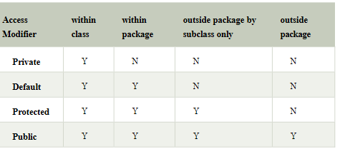
Access modifiers
They specify the scope of a variable or class or method

Slide 15
Constants in Java
A constant is a variable which cannot have its value changed after declaration.
It uses the 'final' keyword.
Syntax
modifier final dataType variableName = value; //global constant
modifier static final dataType variableName = value; //constant within a c

